Slide 1

Virtual Library is OPEN
Click on the covers of the books which you would like to read
Enter Here

Slide 2

Room One
Nursery and Reception
Room Two
Key Stage 1
Room Three
Key Stage 2

Slide 3
















Room One – Nursery and Reception
Audio books – click on the titles and hear the book being read
Audio books – click on the titles and hear the book being read
Click on the titles to read along

Slide 4







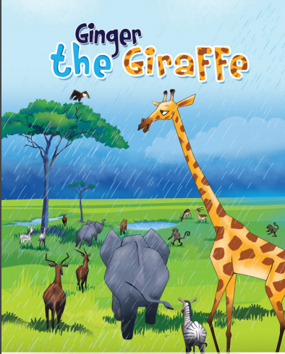







Room Two– Key Stage One
Audio books – click on the titles and hear the book being read
Click on the titles to read along
Click on the titles to read along

Slide 5















Room THree – Key Stage Two
Alternative places to read
Click on the titles to read along
Click on the titles to read along

